Slide 1
The Fall of Paradise: A Visual Journey Through John Milton's Epic Poem

Slide 2
Introduction: The Story of Paradise Lost
The Life of John Milton
The Characters of Paradise Lost
Themes in Paradise Lost
The Structure of Paradise Lost
The Language of Paradise Lost
Paradise Lost and Religion
Reception and Legacy of Paradise Lost
Paradise Lost in Popular Culture
Conclusion: Why Paradise Lost Matters

Slide 3
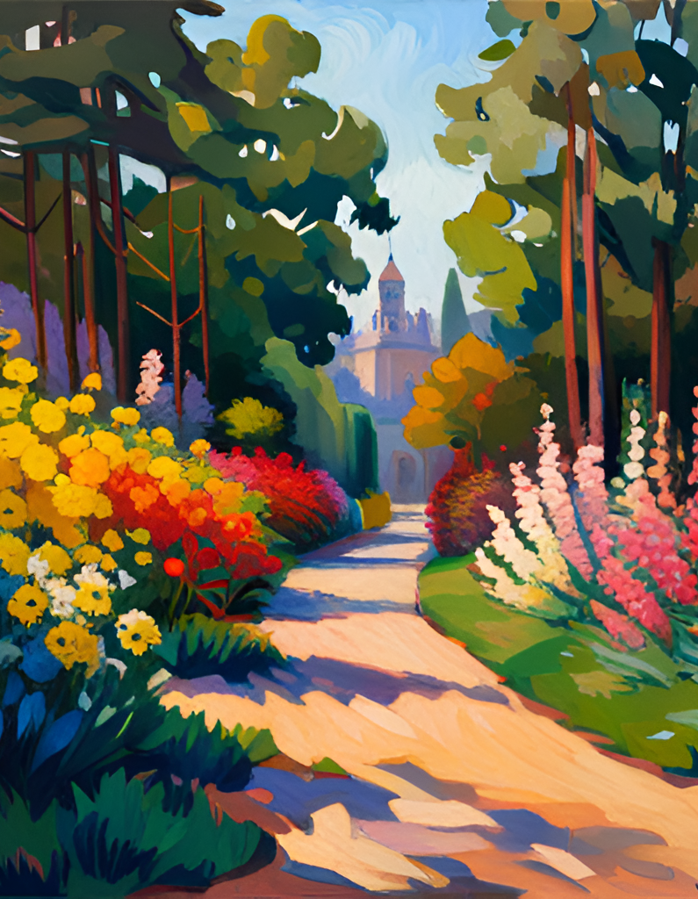
Introduction: The Story of Paradise Lost
Welcome, ladies and gentlemen, to our presentation on Paradise Lost, one of the greatest works of literature ever written. This epic poem, penned by John Milton in the 17th century, tells the story of Adam and Eve and their fall from grace, as well as the rebellion of Satan and his followers against God. But it is much more than just a retelling of a biblical tale. It is a meditation on free will, temptation, and the nature of evil, all set against a backdrop of stunning imagery and language.
What makes Paradise Lost so remarkable is not just its literary merit, but also its enduring influence on popular culture. From film adaptations to rock songs, this poem has captured the imaginations of generations of readers and artists. In this presentation, we will explore the themes, structure, and language of Paradise Lost, as well as its historical context and legacy. So sit back, relax, and prepare to be transported to a world of angels and demons, paradise and hell.

Slide 4
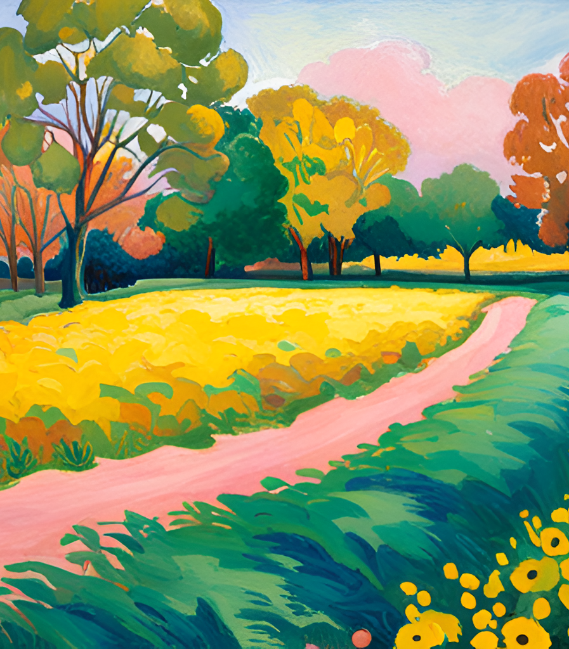
The Life of John Milton
John Milton was born in London in 1608 and grew up in a well-educated family. He attended Cambridge University, where he studied classics and developed a passion for writing poetry. After completing his studies, Milton traveled to Italy, where he immersed himself in the culture and language of the country. Upon returning to England, he began his career as a writer and political activist.
Milton is best known for his epic poem Paradise Lost, which tells the story of Adam and Eve's fall from grace. However, he also wrote numerous other works, including sonnets, political pamphlets, and treatises on theology and education. His writings were characterized by their intellectual depth, complex themes, and powerful use of language. Today, Milton is considered one of the greatest writers in the English language, and his influence can be seen in the works of countless authors who came after him.

Slide 5
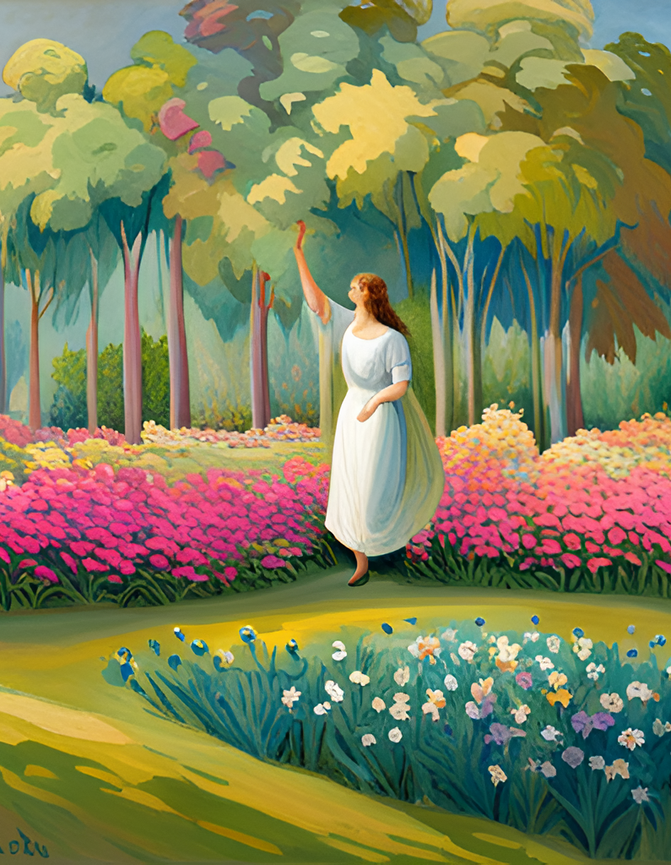
The Characters of Paradise Lost
Paradise Lost is a poem that features a cast of complex and fascinating characters, each with their own motivations and flaws. At the center of the story is Satan, a fallen angel who rebels against God and seeks to corrupt humanity. Despite his evil deeds, Satan is a compelling character, full of pride and ambition, who commands attention whenever he appears on the page.
Adam and Eve, meanwhile, are portrayed as innocent and pure, yet vulnerable to temptation. Their relationship is filled with tenderness and love, but also with conflict and betrayal. As they navigate the challenges of life in paradise, they must confront their own limitations and desires, ultimately leading to their downfall. Milton's vivid descriptions and nuanced characterization make these figures come alive, inviting readers to empathize with their struggles and triumphs.

Slide 6
Themes in Paradise Lost
One of the major themes in Paradise Lost is the fall of man, which refers to Adam and Eve's disobedience and subsequent expulsion from the Garden of Eden. This theme explores the consequences of human actions and the role of free will in shaping our destiny.
Another important theme in Paradise Lost is temptation, which is closely linked to the fall of man. Satan tempts Eve with the forbidden fruit, leading to her decision to disobey God's commandment. This theme raises questions about the nature of temptation and the human capacity for self-control.

Slide 7
The Structure of Paradise Lost
Paradise Lost is a poem that follows the conventions of epic poetry, with its focus on heroic characters and grand themes. The poem is divided into twelve books, each with its own distinct structure and narrative arc. Milton's use of classical references and Christian mythology creates a unique blend of literary traditions that sets Paradise Lost apart from other works of its time.
One of the most striking features of Paradise Lost is its use of blank verse, a form of poetry that uses unrhymed lines of iambic pentameter. This gives the poem a natural and flowing rhythm that captures the grandeur and complexity of Milton's vision. The poem also makes use of rich imagery and vivid descriptions, creating a world that is both familiar and fantastical.

Slide 8
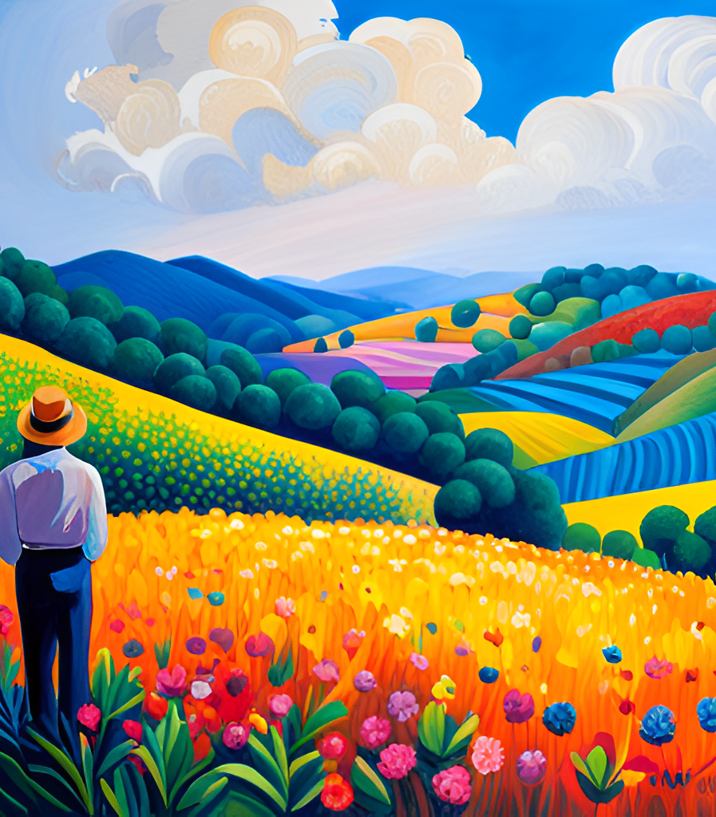
The Language of Paradise Lost
Milton's use of blank verse is one of the defining features of Paradise Lost. This unrhymed iambic pentameter gives the poem a natural, flowing rhythm that mirrors the ebb and flow of human speech. It also allows Milton to vary the length and structure of his lines, creating a sense of musicality and complexity that draws the reader in.
In addition to its use of blank verse, Paradise Lost is known for its rich imagery. Milton uses vivid and detailed descriptions to bring his characters and settings to life, from the fiery depths of Hell to the lush gardens of Eden. His use of metaphor and symbolism adds depth and meaning to the text, inviting readers to explore the poem on multiple levels.

Slide 9
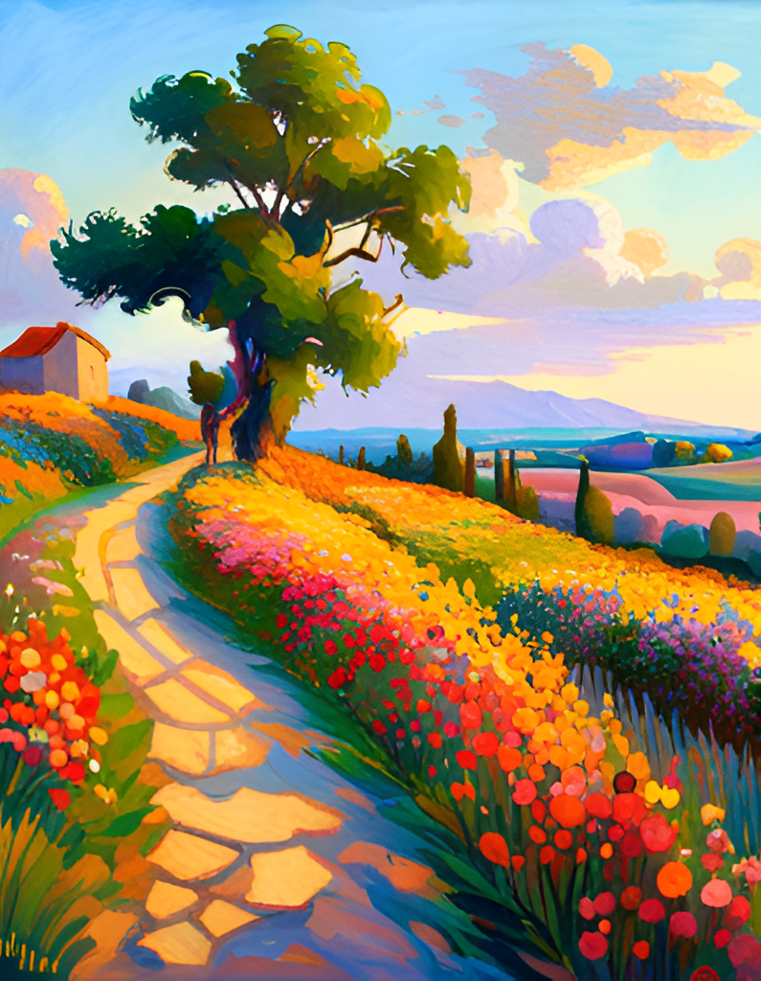
Paradise Lost and Religion
Religion plays a central role in Paradise Lost, as Milton draws heavily from Christian theology to explore themes of free will and predestination. The poem presents a complex vision of God, one that is simultaneously loving and just, but also mysterious and inscrutable. At the same time, Milton grapples with the problem of evil, asking how a benevolent God could allow sin and suffering to exist in the world.
One of the most striking aspects of Paradise Lost is its portrayal of Satan, who rebels against God out of pride and envy. While Satan is often seen as a symbol of evil, Milton's depiction of him is more nuanced, showing how his rebellion is rooted in a desire for freedom and self-determination. This raises important questions about the nature of free will and the relationship between God and humanity.

Slide 10
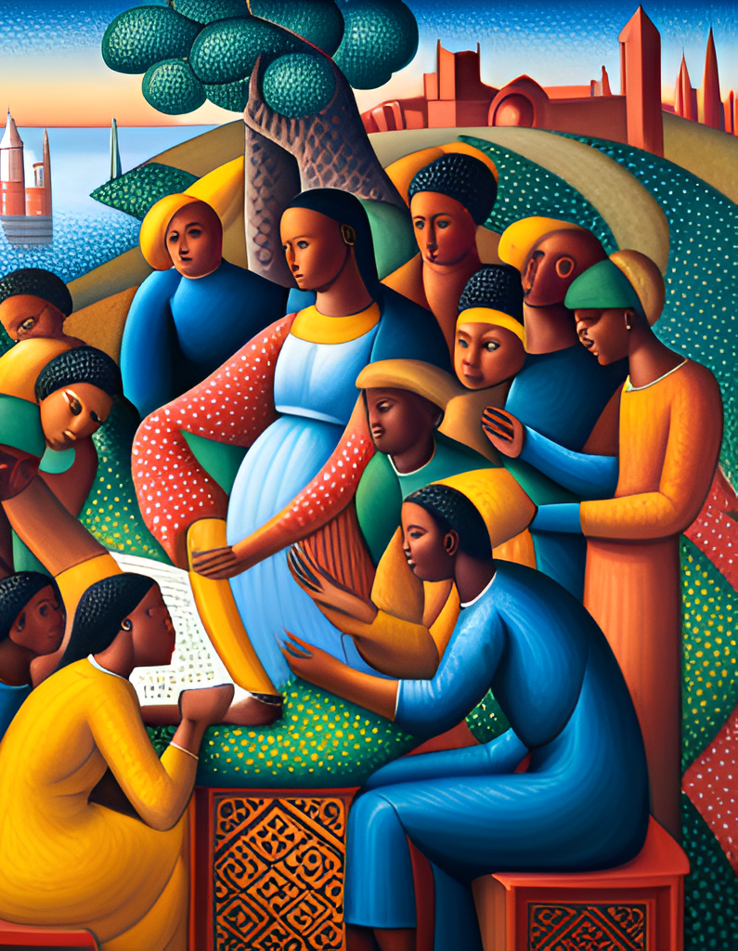
Reception and Legacy of Paradise Lost
Paradise Lost has had a profound impact on literature since its publication in 1667. It is widely regarded as one of the greatest epic poems in the English language and has influenced countless writers over the centuries. Its themes of temptation, sin, and redemption continue to resonate with readers today.
The poem's reception was mixed when it was first published, but it quickly gained popularity and has remained an important work of literature ever since. It has been praised for its rich imagery, complex characters, and insightful exploration of religious themes. Many writers, including William Blake, Percy Bysshe Shelley, and T.S. Eliot, have been inspired by Milton's masterpiece and have incorporated elements of Paradise Lost into their own works.

Slide 11
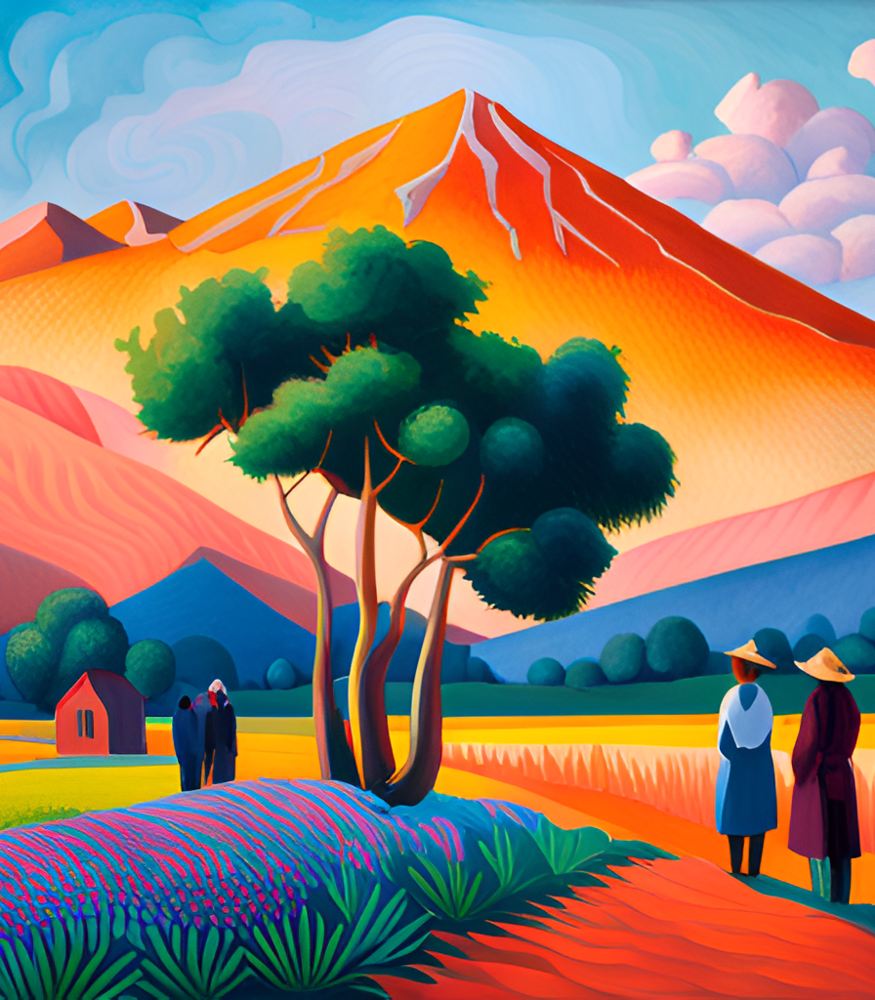
Paradise Lost in Popular Culture
Paradise Lost is a literary masterpiece that has had a profound impact on popular culture. From film adaptations to references in music and television, the story of Adam and Eve's fall from grace continues to captivate audiences today.
One notable adaptation of Paradise Lost is the 2005 film adaptation directed by John Allyn. The film features stunning visuals and a talented cast, including Benicio del Toro as Satan and Jennifer Garner as Eve. The film stays true to the themes and characters of the original poem while also bringing its own unique interpretation to the story.

Slide 12
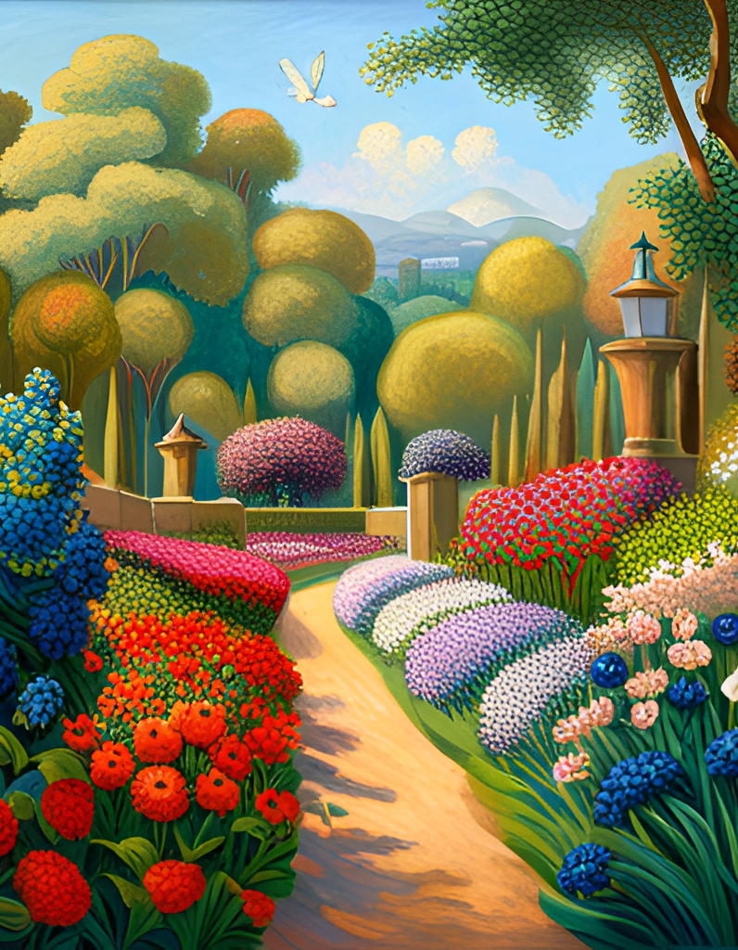
Conclusion: Why Paradise Lost Matters
In conclusion, Paradise Lost is a truly remarkable work of literature that continues to captivate readers today. Through its exploration of complex themes such as the fall of man, temptation, and redemption, it offers a profound insight into the human condition. Milton's use of epic conventions, Christian mythology, and rich imagery creates a unique and powerful reading experience that has stood the test of time.
Furthermore, Paradise Lost has had a lasting impact on literature and popular culture. It has inspired countless writers and artists, and its influence can be seen in everything from film and television to music and advertising. Its enduring relevance is a testament to its importance as a work of art.

